Slide 1
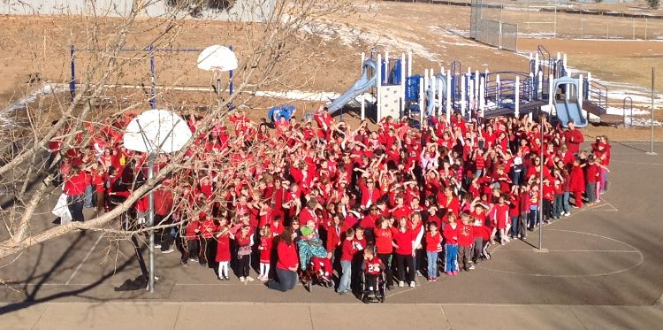

Superintendent Report
Student Safety and Supports
September 12, 2023

Slide 2

Commitments and Values
Notes:
Erin Kane

Slide 3
BOE Ends Alignment
Safe, Positive Culture and Climate
A purposeful focus on creating a caring, safe, fun, supportive, and positive learning and working environment for all students, district employees, parents, and community is manifest throughout the district.
There is clear evidence and a common understanding of the shared belief that all students can succeed when given a safe and caring learning environment. To that end:
  District employees, parents, and community work collaboratively, proactively and responsibly to ensure the psychological wellbeing of all students.
  A focused level of teamwork and professional development is ongoing among district employees, community, and law enforcement agencies to ensure the physical safety of students, district employees and visitors.
Behavior Expectations are clearly articulated, supported, and taught.
Multiple communication systems are available and used by students, district employees, parents, and community to ensure all voices are heard.
Notes:
Danelle

Slide 4
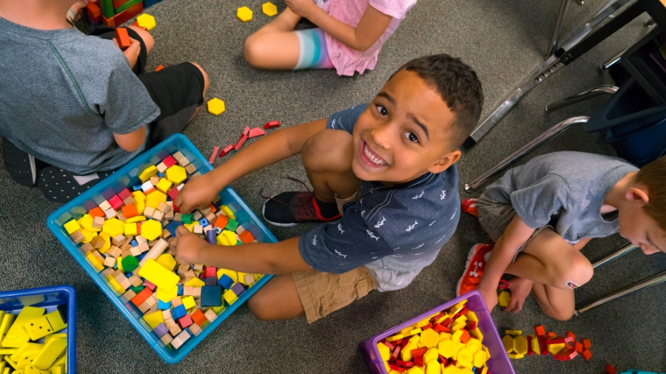
District Goals and Priorities
Superintendent Goal 2: Climate and Culture
System Priority: Essential Skills for Success
Monitoring Report - Safe, Positive Climate and Culture (Second Semester 2024)
○ Indicator 1 - Teaching and Learning Conditions Colorado - Managing Student Conduct
○ Indicator 2 - Healthy Kids Colorado Survey - Health Topic - School
○ Indicator 3 - Safety and Security Trainings
○ Indicator 4 - Mental Health Trainings
○ Indicator 5 - Safety and Security Continuous Improvement
Notes:
Danelle

Slide 5

BOE Ends
What systems and supports do you have to improve achievement and promote belonging and engagement for all students?
*Professional Learning Communities
Culture
  Alternatives to Suspension
    Practices Research
Integrated Multi-Tiered System of Supports
Shared Leadership
Family, School & Community Engagement
Student Outcomes
Focus on Results
Improve Achievement and
Growth for all Students
Promote Student Engagement
and Belonging
Focus on Learning
*Data Driven Decision
Making
Layered Supports
*Academic, Social, Emotional and Behavioral Wellness
*CO Standards & *Essential Skills
*Tier I-Universal/Prevention
Tier II-Targeted Intervention/Acceleration/Enrichment
Tier III-Intensive Intervention/Acceleration/Enrichment
BOE Ends
Academic Excellence
Outstanding Educators & Staff
Safe, Positive Culture & Climate
Collaborative Parent, Family, & Community Relations
*DCSD Priorities
Literacy, Data-Driven Professional Learning, Essential Skills, Pathways
Screening & Assessment
*Collaborative Culture
Foundational Practices
Relationships, Culturally Responsive & Sustaining, Trauma-Informed
Notes:
Danelle

Slide 6
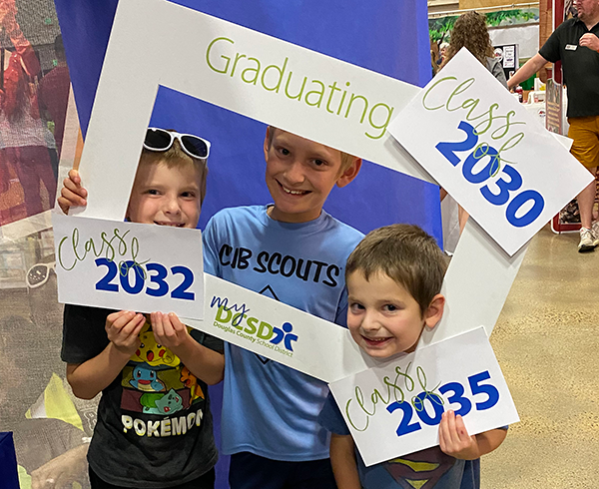
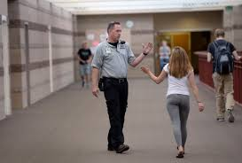
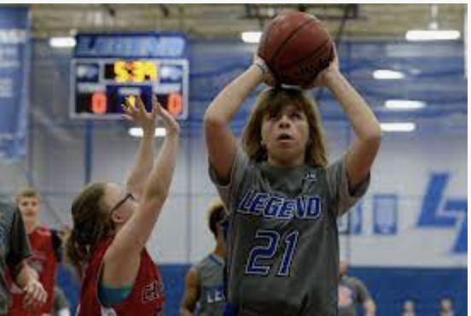
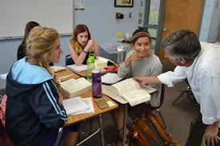
System of Supports
What systems are in place to ensure a safe environment, address bullying and support the behavioral, social and emotional needs of students?
Notes:
Danelle

Slide 7
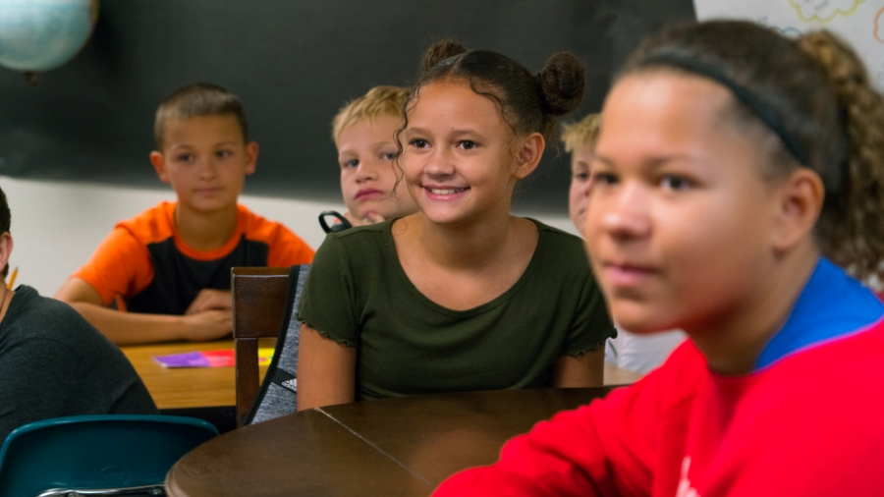
Positive School Climate and Culture
Strong relationships and trusted adults
High academic expectations with supports
Consistency in behavioral expectations
Safe and orderly
Student empowerment
Community building
Notes:
Danny

Slide 8
Integrated Systems to Ensure Student Success
Defining our Foundational Practices for ALL
  Relationships, Engagement, Culturally Responsive and Sustaining Practices and Trauma Informed Teaching
Supporting a Culture of Learning for Staff and Students
  Professional Learning Communities
Clear and Consistent Implementation of an Integrated System to Support ALL
  Integrated Multi-Tiered System of Supports

Slide 9
School Safety and Mental Health Supports
Enhanced our lockdown drill procedures by adding a student education component
  Safe2Tell process
  Teaching students how to respond in unstructured settings and during transitions
Safe2Tell Protocol
  Every Safe2Tell report is received and responded to by school administration and others depending on circumstances
Psychological Safety Assessment and Support
  Self-Injury, Suicide Risk Assessment, Threat Assessment
Community Partnerships
  Handle With Care, Youth Community Response Teams, Developmental Pathways, DCYI, Aspen Effect
Notes:
Jonny and Stephanie

Slide 10
School Safety and Mental Health Supports
Training and Development
On-going and enhanced safety trainings for administrators and staff
  Additional Standard Response Protocol, School Response Management and Reunification training at the District and school levels
  SROs, Mental Health and Administrators-The Role of the SRO
    Training for supporting students with disabilities and those with Behavior Intervention Plans
  Secondary administrators received on-site and standardized search procedure training
Mental Health professional learning focused on targeted and intensive supports in collaboration with special education
Keeping Students Safe mandatory training for all staff
Notes:
Jonny and Stephanie

Slide 11
Universal Student Supports
Colorado Comprehensive Health Standards Instruction
Lessons and units focused on health and wellness by classroom, health and physical education teachers
Using the CDC Whole School Whole Community Whole Child Framework (WSCC) our School Nurses Lead Wellness Lessons in schools based on Healthy Kids Colorado Survey Data identified needs
Prevention Nurses Piloting a Substance Use Prevention Model
  Components include, class instruction, intervention if using, and staff, parent and community education (Johnny’s Ambassadors, Catch My Breath)
School Resource Officers work with all 6, 7, and 8th graders teaching the YESS Program, lessons that cover healthy relationships, digital citizenship, and drugs
Notes:
Kelli

Slide 12
Universal Student Supports
School Engagement and Belonging
Schoolwide Culture Activities
  Advisement, Access, Academies, Assemblies, Wish Week, Feeder HOCO Week, Themed Events
Experiential Education
  Immersing students in hands-on experiences and reflection to develop collaboration skills, leadership skills and capacity to contribute to their communities
Student Involvement/Connection with a Trusted Adult
  Clubs , Athletics, and Activities
Student Government, Girls on the Run, AVID, Peer Leaders, Peer Counseling, Student Advisory Group, Playworks, SHINE Summit
HS/MS Advisory Class- Same students for several years, building leadership and relationships
Pathways for All Students
Explore and engage with their passions and be connected with students with similar interests and passions
Notes:
Danny

Slide 13
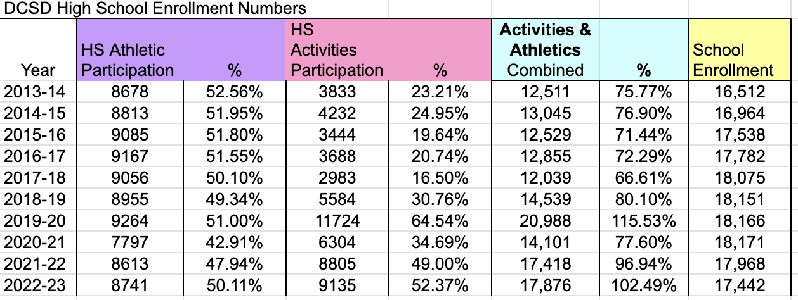
Student Involvement: Connected to a Trusted Adult
Research says …
Branch (2003) found significant differences between the academic achievement of students who did and did not participate in school-sponsored extracurricular activities.
Students who participated in extracurricular activities had the highest GPAs, followed by athletes as a sub-group.
Most researchers agree that structured activity participation was linked to many positive academic, behavioral, psychological, and young adult outcomes. (NFHS and NIAAA Study)
Notes:
Danny

Slide 14
Universal Prevention and Programs
DCSD School Counseling Curriculum K-12
  School Counselors teach specific skills in the areas of learning strategies, self-management skills , social skills and bully prevention
    Mindsets and behaviors K-12
Schoolwide Foundational Practices to Support Students
  Positive Behavior Intervention Supports, Restorative Practices and Trauma Informed Practices
Student Bullying, Harassment and Discrimination Training
SMARTS
GoZen
Second Step
Sources of Strength
Zones of Regulation
Mind Up
Signs of Suicide
Restorative Practices
Common Sense Media
Character Development Through IB, Leader In Me, EL Education
Notes:
Danny and Kelli

Slide 15
Targeted Student Supports
Mental Health Support (nurses, counselors, school psychs and social workers)
  Instruction on lagging skills in one-on-one or group lessons
  Bullying supports
Sensory or Homebase - individual support for students who need more practice with behavior regulation or agency
Behavior Intervention - students needing more support for behavior as identified through a referral process, will be provided behavior support in a written plan by a collaborative team including parents
Individualized Educational Plan, Behavior Support Plan, 504 Plan, Attendance Plans, RtI Plan, Multilingual Learner Plan, Advanced Learner Plan, READ Plan
  Individualized supports/accommodations/modifications/services for academics, behavior, social or emotional learning
Notes:
Danny and Kelli

Slide 16
Intensive Student Supports
Mental Health Support (nurses, counselors, school psychs and social workers)
  Suicide or threat assessment screeners/intervention
Outside partnership referral for mental health therapy or community-based resources
Health Plan, Individualized Educational Plan, Behavior Support Plan, 504 Plan, Attendance Contract, Multilingual Learner Plan, Advanced Learner Plan, READ Plan
  Individualized supports/accommodations/modifications/services for academics, behavior, or social emotional instruction
Behavior Specialist and Autism Specialist
  Individualized based on student needs
DCSD Student Assistance Team
Notes:
Danny and Kelli

Slide 17
School and District Reporting Systems
Concerns, complaints and grievances from students and district parents/guardians are best handled and resolved as close to their origin as possible
    Teacher or Other Staff Member (e.g., coach, educational aide, etc.)
    Building Administrator
    Executive Director of Schools (based on region)
    Deputy Superintendent and/or Assistant Superintendent
    Superintendent of Schools
    Board of Education
Safe2Tell Protocol
  Every Safe2Tell report is received and responded to by school administration and others depending on circumstances
Title IX, harassment and discrimination reporting, collaboration and support from Compliance Office when needed
Notes:
Danny

Slide 18
School Experiences
Goal 1: Develop, identify, and refine a baseline of research based practices of universal support for academic and behavioral growth and achievement.
Goal 2: Develop and refine targeted support or all students who need intervention or acceleration.
Goal 3: Leaders will understand and implement effective professional learning communities at each site.
Goal 4: Increase stakeholder awareness of postsecondary pathways and courses available to students. Increase the number of stackable course pathways for students and the access to those pathways for all students.
Eagle Academy
South Ridge Elementary School
Roxborough Intermediate Elementary School
Redstone Elementary School
Sierra Middle School
Rock Canyon High School
Notes:
John Gutierrez

Slide 19

Alternative Education: Eagle Academy - Jeff Broeker
Vision: Eagle Academy embraces a caring and positive family model empowering students to gain confidence and take initiative building a fulfilling future founded on personal balance and healthy, nurturing relationships.
Developing Mini-Segments for second semester
  “How to” lessons to navigate personal mental health at school
Mental Health Team (Examples of collaboration to meet student needs)
  Transition Counselor
  At-Risk Counselor
  Academic Counselor
  Social Worker

Slide 20

Elementary School: South Ridge Elementary
South Ridge inspires
COMMUNITY,
BELONGING,
and PURPOSE
through our pursuit of excellence in
ACHIEVEMENT,
in CHARACTER,
and in the ways we TAKE ACTION to impact our world.
What it means to be a Wolf: We are a PACK. We are Principled, Always Safe, Caring, and Knowledgeable (PBIS)
Our Learner Profiles: Caring, Knowledgeable, Inquirers, Thinkers, Communicators, Principled, Open Minded, Risk Takers, Balanced, and Reflective
Our Theme: We believe in the power of YET

Slide 21
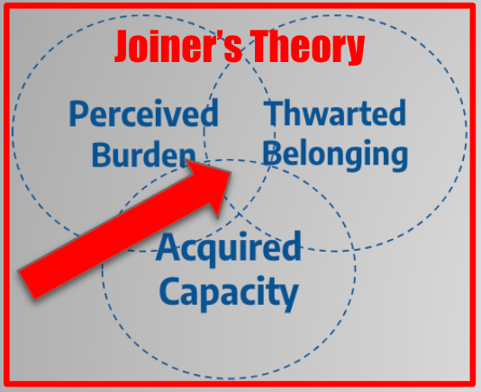
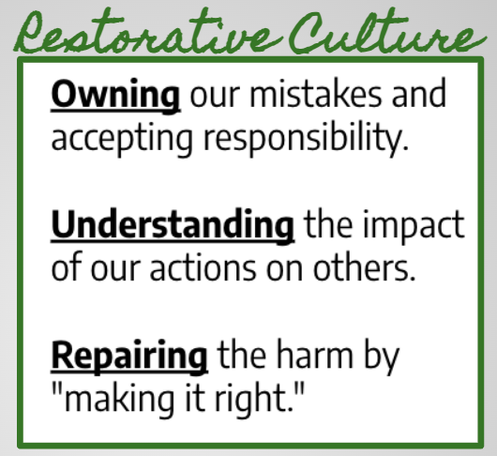
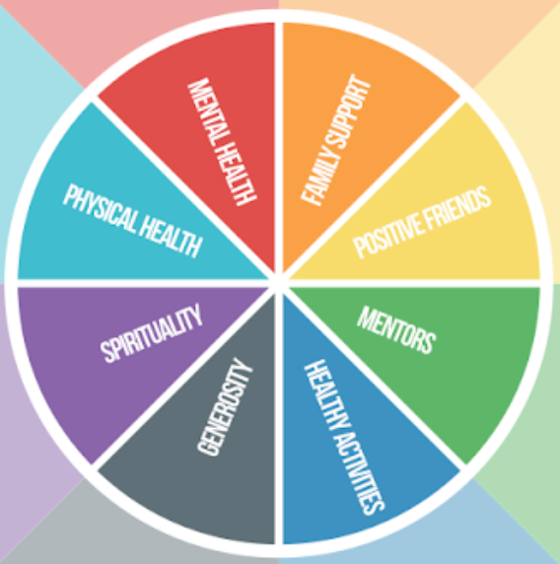


Roxborough Intermediate Bully Prevention
Collective Efficacy
Morning Meetings
Skill Building
Ambassadors
Student Mentors
Trusted Adults
Home Base Program
Community Service
Documentation
Kids do well if they can!
Notes:
Meghan

Slide 22


Elementary School: Redstone Elementary
Mission: A School of Possibilities
Vision: We Will Reach Every Child Every Day
Theme: The Power of WE at Redstone
We work collaboratively as a staff and build partnerships with families to best support ALL students at Redstone.
We are a Leader in Me School. We believe that EVERY student is a leader and we intentionally recognize, develop and nurture the leadership potential in all students. Our goal is for ALL students to feel valued, loved, included and important each and every day.
Student Connections and Supports
Staff Connections and Supports
Family Partnerships and Supports

Slide 23
Elementary School: Redstone Elementary
Student Connections and Supports
Monthly Leader in Me Habit Assemblies
Daily Announcements and Class Morning Meetings
Classroom Leader in Me Lessons
Student Accountability Partners
5th Grade Kindness Crew
Student Leadership Roles
Student Lighthouse Team
Counselor Tier 1 Lessons for All Students
Counselor Checks-ins and Visibility
Staff Connections and Supports
Staff Action Teams
Staff PD Opportunities
  Calming Corners, Zones, Kids Do Well if They Can
Kid Talks
Data Conversations
Family Partnerships and Supports
Family Learning Opportunities
Principal’s Coffees
Positive Phone Calls
Watch Dog Dads
Kid Talks

Slide 24

Middle School: Sierra Middle School
What is means to be an Eagle (S.O.A.R.)
  The Best in the Business
  You are the most important decision maker in your life
  School benefits you!
Structures, Systems, & Programming
  Safety, Opportunity, Accountability, Respect
  3 = 33
  Advisory structure and lessons
  Sources of Strength
  Student Council
  Intentional structure to our teams and schedule
Monitoring
  Behavior data - quarterly, yearly
  Mental Health Team & Grade Level Teams - weekly meetings
  Student and parent surveys
  Safety Check In with Principal

Slide 25

High School: Rock Canyon High School
Shared Values, Perceptions and Beliefs (All Stakeholders)
  “It’s a great day to be a Jag!”
  How are we making others feel
  Value = Increased Performance, Positive Behavior, Safety & Security
Encouraging and Maintaining Respectful, Caring and Trusting Relationships
  Lead by example with positive interactions even in the face of adversity
  Build relationships with stakeholders by understanding and knowing each other
  Consistent communication and follow through
Delivery - Showcase
  RCTV, Class Meetings, Meeting and Greeting, Community Presentations, Visibility & positive interactions with stakeholders, accountability for unaligned actions
  Celebrating what we value. In Class, Assemblies, RCTV, Newsletters & Social Media. Jags of the Month / Year, Rockstar, Parent Volunteers, Spot the Jag, Underclass Awards, Moving up Ceremony, Athletic & Activity accolades, Honors Night, Graduation

Slide 26
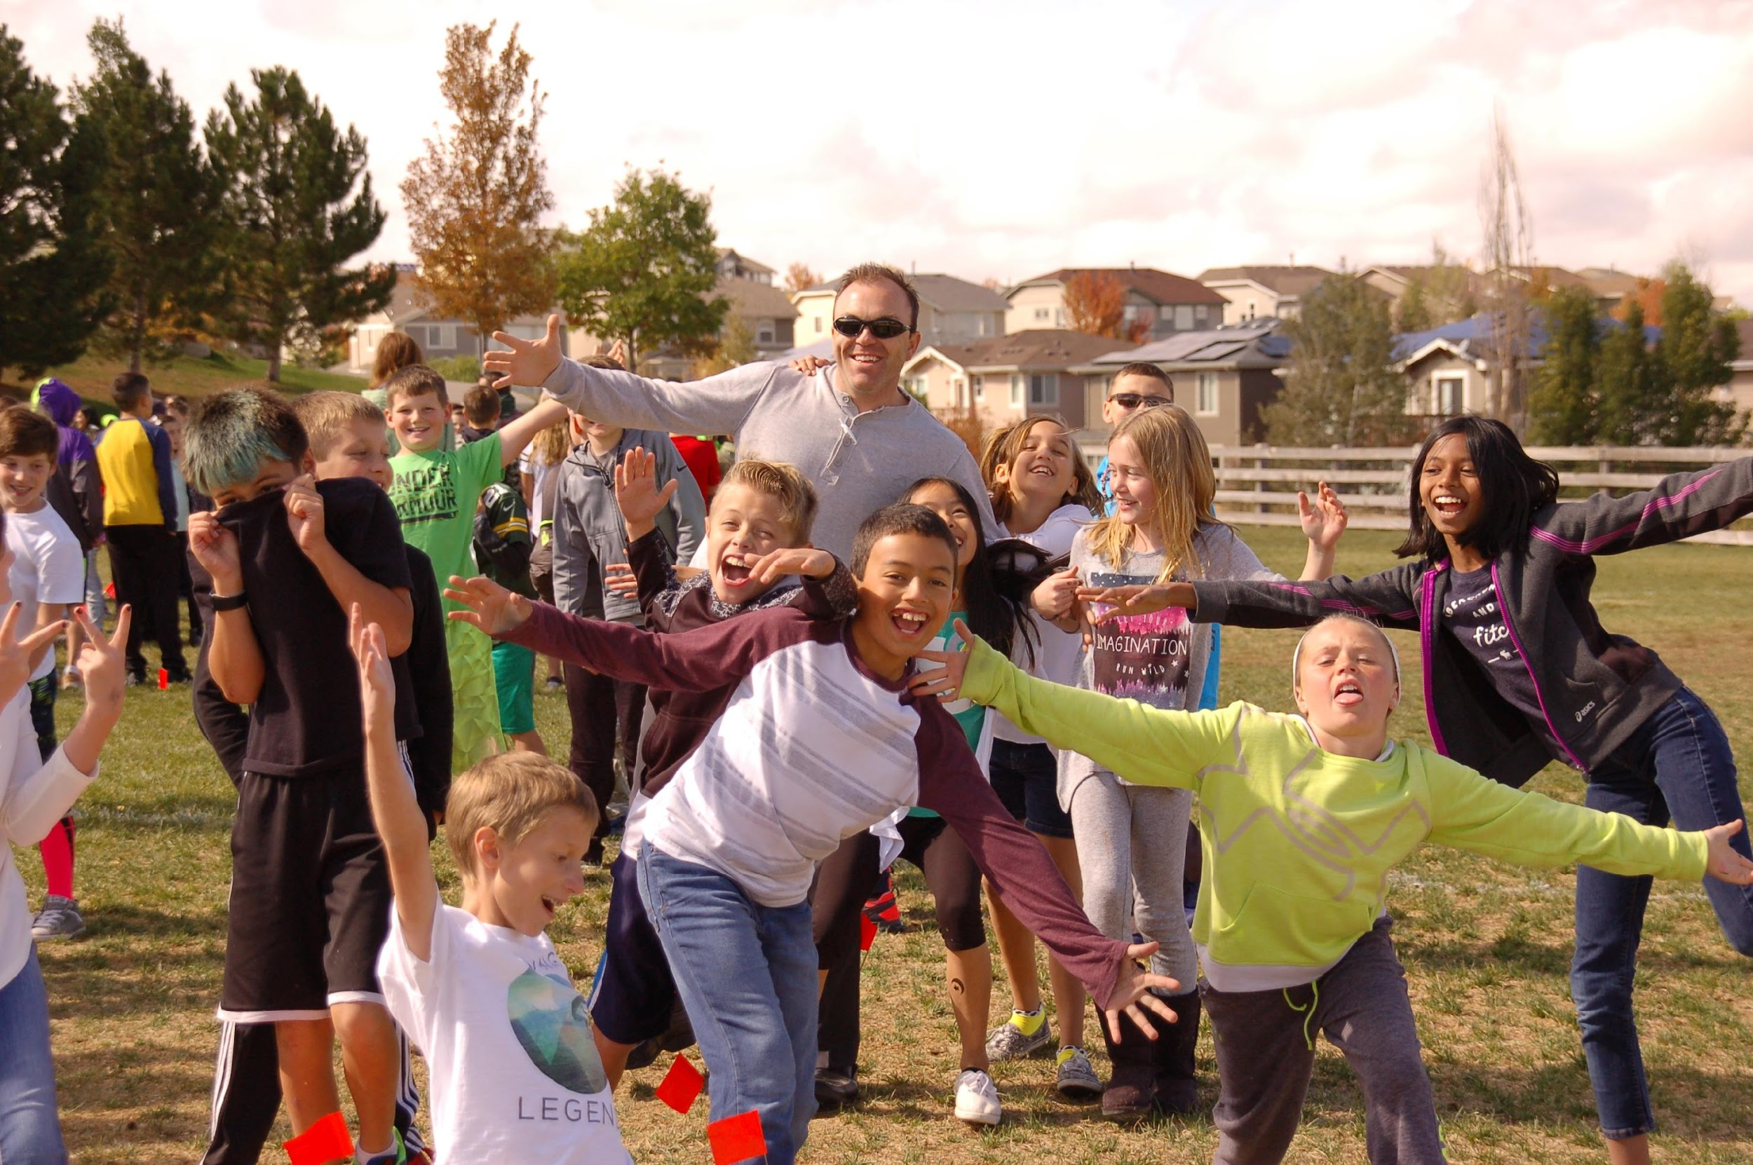
Questions
Notes:
Closure:
Continuous improvement and always a work in progress..
Progression of supports…
Schools are constantly revising to get back at what we do….

